Slide 1
Grammar of graphics
The basic idea: independently specify plot building blocks:
data
aesthetic mapping
geometric object
statistical transformations
scales
coordinate system
position adjustments
faceting

Slide 2
To use ggplot2
install.packages("ggplot2")
library("ggplot2")

Slide 3
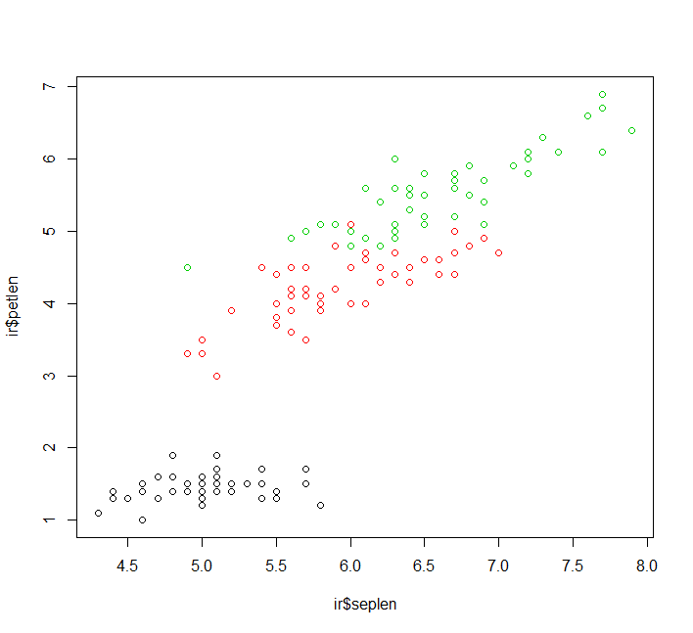
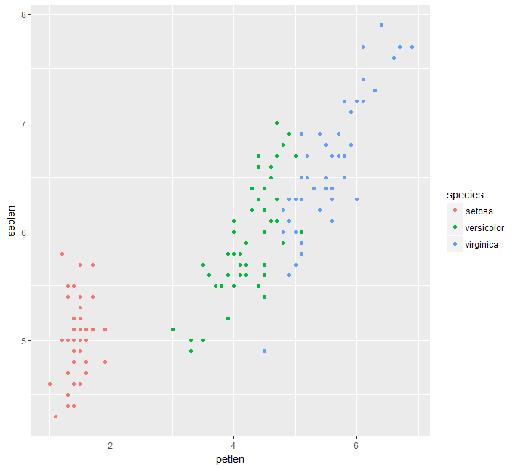
Some examples
plot(ir$seplen,ir$petlen,col=ir$species)
ggplot(data=iris,aes(x=petlen,y=seplen,col=species))+
geom_point()

Slide 4
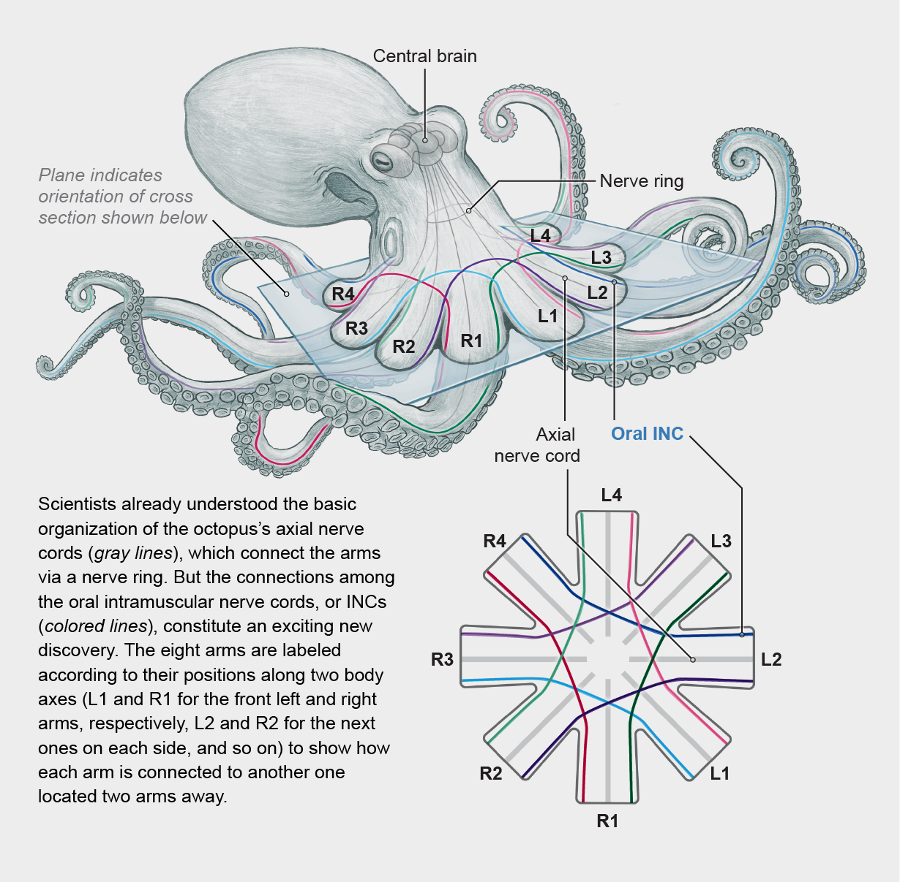
The octopus approach

Slide 5
The octopus approach
Each geom_ is an autonumus unit
Each geom_ can work with its own data, and you can manipulate the size, the shape, alpha… of each geom_ individually.
In the absence of data, a geom_ ”looks up” for insturction form the ggplot() parental function.

Slide 6
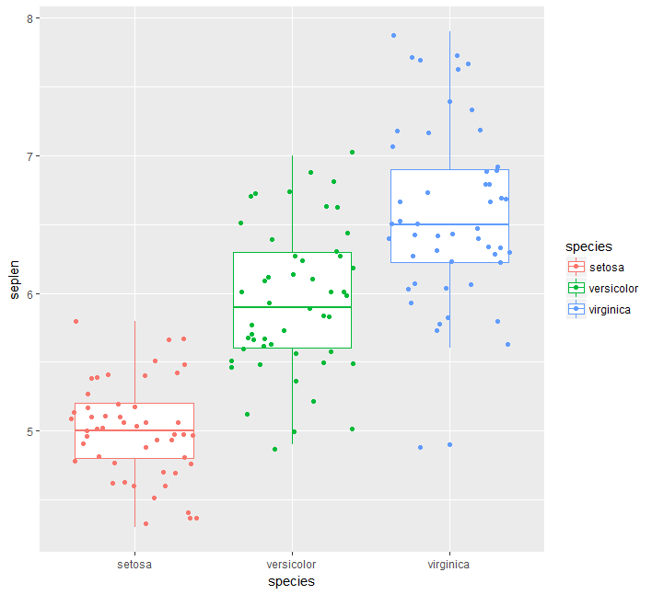
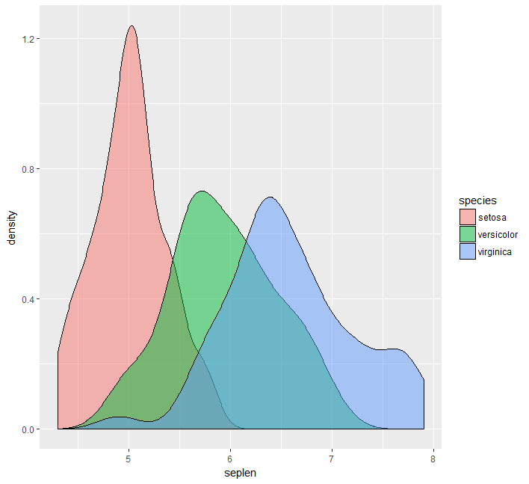
Identical data – but a different representation

Slide 7
Building blocks of a ggplot
1. Aesthetics (aes)
2. Geometric Objects (geom)
3. Statistical Transformations (stat)
4. Scales
5. Faceting
6. Themes

Slide 8
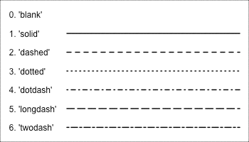
Aesthetics and geometric Objects: Mapping aesthetics
Aesthetic mappings are set with the aes( ) function
Position (x and y)
Color (outline color)
Fill
Shape (point shapes )
Line type
Size
Each geom accepts only a subset of all aesthetics

Slide 9
Aesthetics and geometric Objects: Geometric objects
Geoms are the ways of representing marks on a plot
Points (geom_point: dot plots, scatter plots)
Lines (geom_line: trend lines, timeseries)
Boxplot (geom_boxplot)
At least one geom is required (no upper limit)
Geoms are added to the plot using the + operator

Slide 10
Some examples
ggplot(data=ir,aes(x=petlen,y=seplen,col=species))+geom_point()

Slide 11
Some examples
ggplot(data=ir,aes(x=species,y=seplen,col=species))+geom_boxplot()+geom_jitter()

Slide 12
Some more examples
ggplot(data=ir,aes(x=seplen,col=species))+geom_density()
ggplot(data=ir,aes(x=seplen,col=species))+geom_density()+geom_jitter(aes(y=0.2))
ggplot(data=ir,aes(x=seplen,fill=species))+geom_density(alpha=0.5)

Slide 13
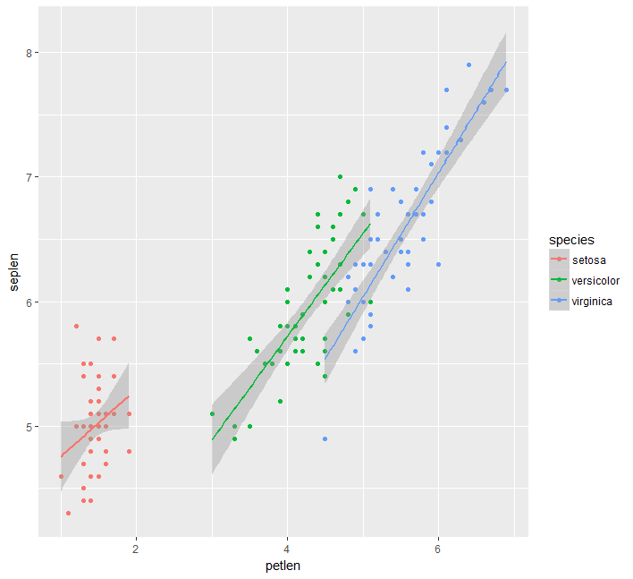
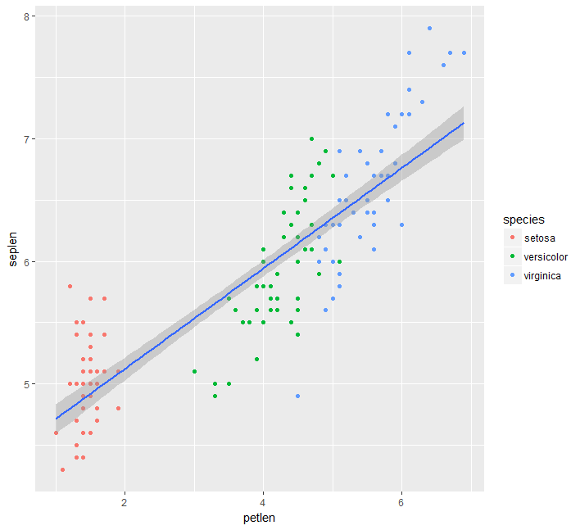
Some examples
ggplot(data=ir,aes(x=petlen,y=seplen,col=species))+geom_point()+geom_smooth(method="lm") #linear model performed for each group separately
ggplot(data=ir,aes(x=petlen,y=seplen))+geom_point(aes(col=species))+geom_smooth(method="lm") #lm for entire dataset

Slide 14
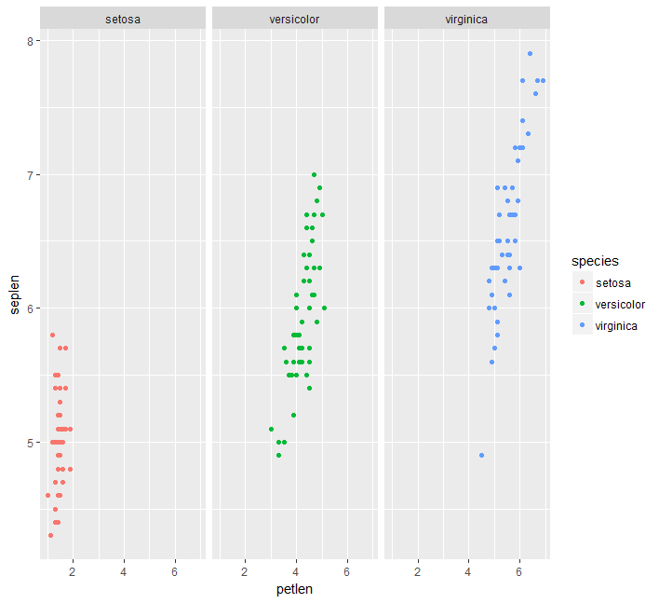
Some examples
ggplot(data=ir,aes(x=petlen,y=seplen,col=species))+geom_point()+facet_wrap(~species)

Slide 15
Themes: rapid adjustment of visualization style
p=ggplot(data=ir,aes(x=petlen,y=seplen,col=species))+geom_point()+facet_wrap(~species)
p+theme_bw()
p+theme_classic()
p+theme_minimal()

Slide 16
Saving a ggplot
ggsave("plotname.pdf",plot=p) #if plot parameter is not defined, the last generated plot will be saved

Slide 17
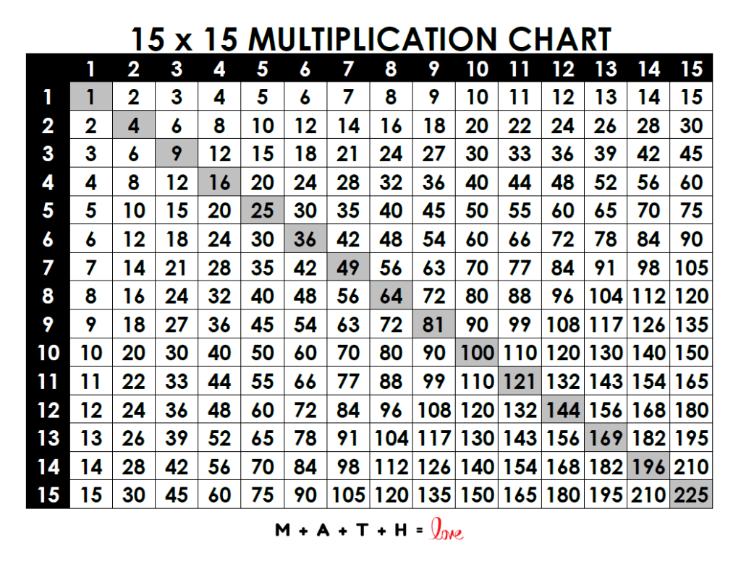
Using a loop within a loop

Slide 18
‘apply’ functions
The “apply” family functions is a collection of functions that replace loops for iterating in R, efficiently and with short and easy syntax.
There are different “apply” functions for different outputs and inputs.
We will go over the basic “apply” types

Slide 19
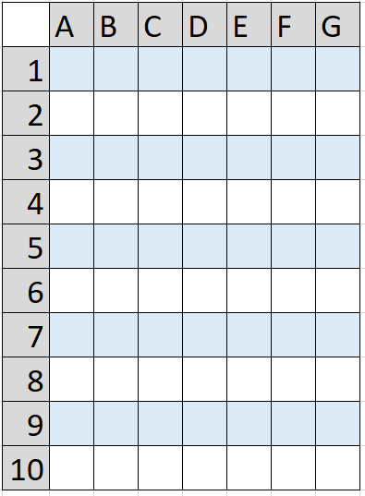
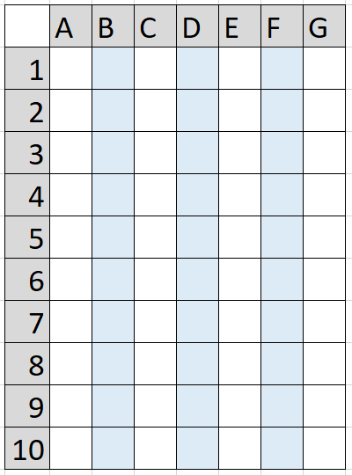
apply()
1
2
iterates on either the rows or the columns of a data-frame / matrix
Input: data-frame / matrix
Output: usually a vector
Similar to lapply, but takes one more argument, syntax:
apply ( input_df, margin, FUN = a_function )
Where the index is either 1 for iterating on rows or 2 for iterating on columns

Slide 20
lapply()
The “l” stands for lists
Input: list/vector
Output: list
lapply() will iterate of each element in the list and perform a function
Syntax:
lapply ( input_list, FUN = a_function )
With a for loop it would be:
For ( element in input_list ) {
out = a_function(element)
new_list[new] = out
}

Slide 21
sapply()
S stands for simplify
Works very similar to lapply() but simplifies the output
May work in unexpected ways when simplifying

Slide 22
Making you own functions inside “apply”
You can make apply run any function, even ones you made yourself
A nice feature to use is defining temporary functions within the apply run
You define the function without naming it, syntax:
apply ( input_df, margin, FUN = function(x) {YOUR_CODE on x})
The curly brackets are optional here.
Examples:
apply ( iris[1:4], 1, FUN = function(x) 2*sum(x)/x[1] )
apply ( iris[1:4], 1, FUN = function(x) paste(x[1],” first, ”,x[4],” last.”) )

Slide 23
Bonus functions
rowSums(df) does the same as apply(df,1,sum)
Also:
colSums(), rowMeans(), colMeans()

